Slide 1
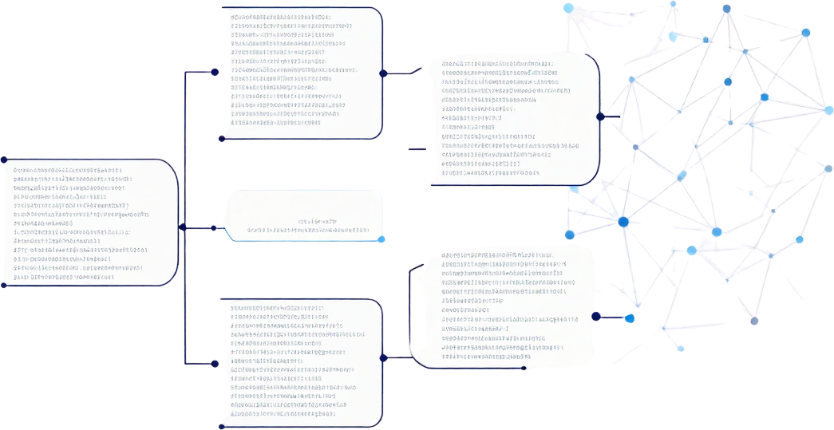


Rohit Raj Singh
Software Engineering Intern
What I Learned in My First Five Days as an Engineering Intern
Project: Week 1 Learnings

Slide 2
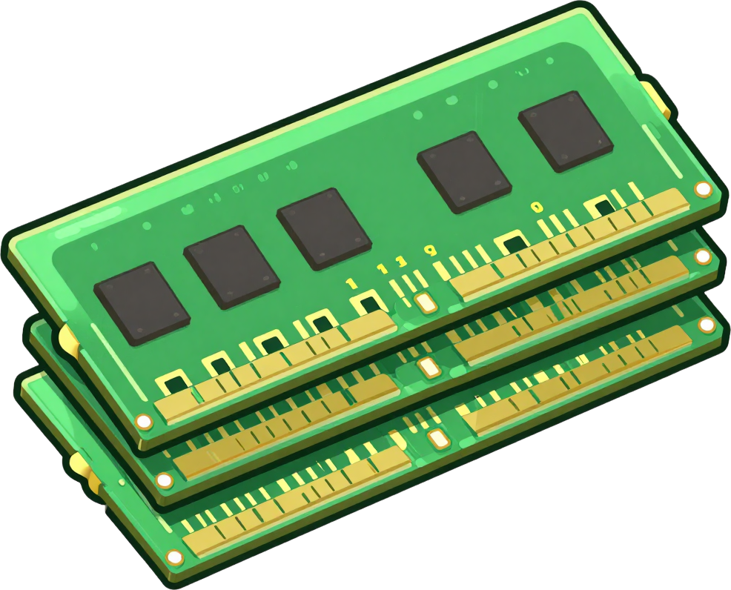



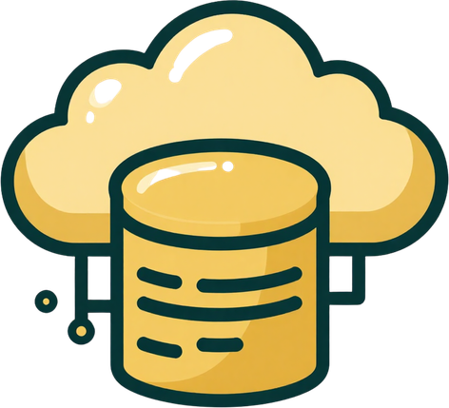
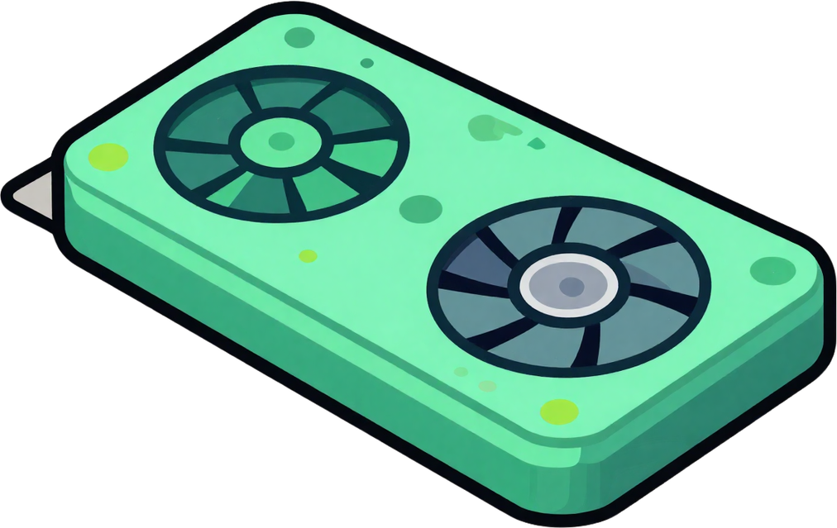
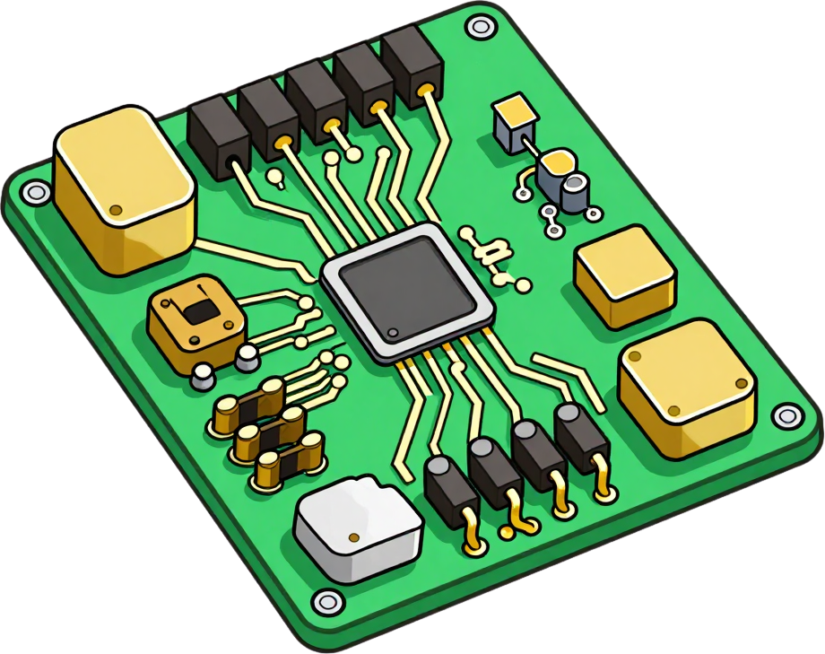


Day 1
Engineering &
Product Foundation
Software Development Learning Journey

Slide 3
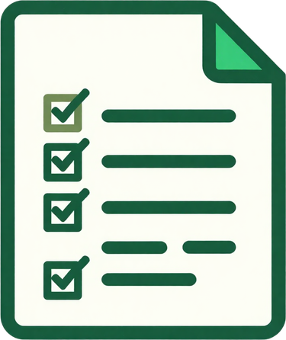
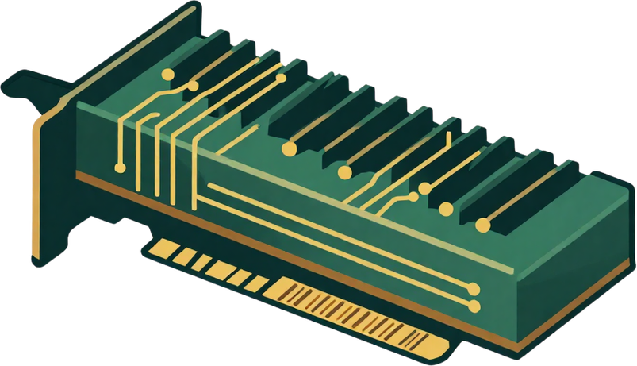

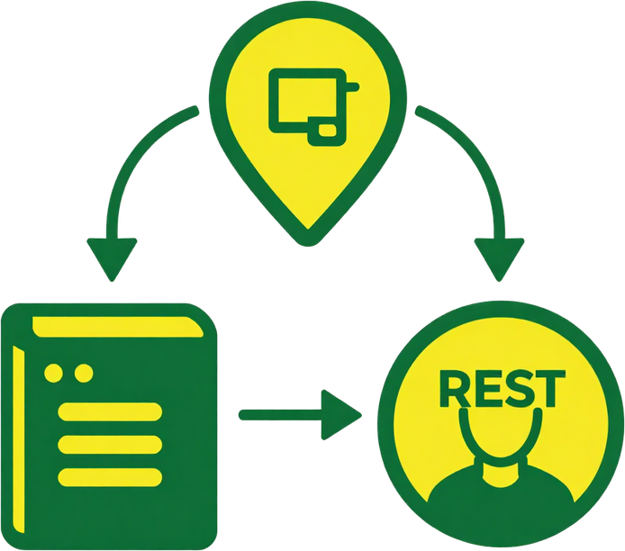
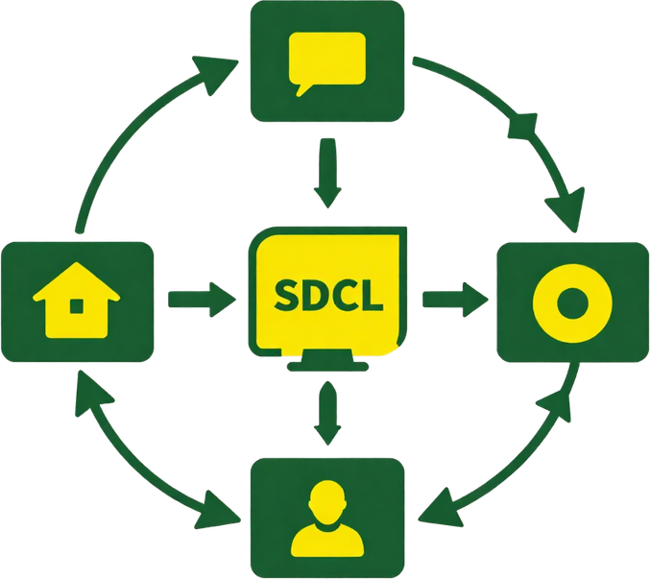
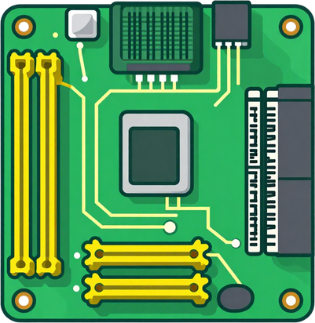
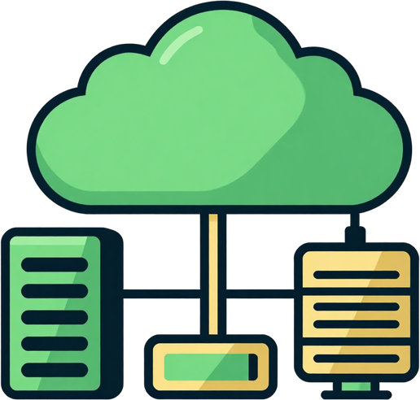
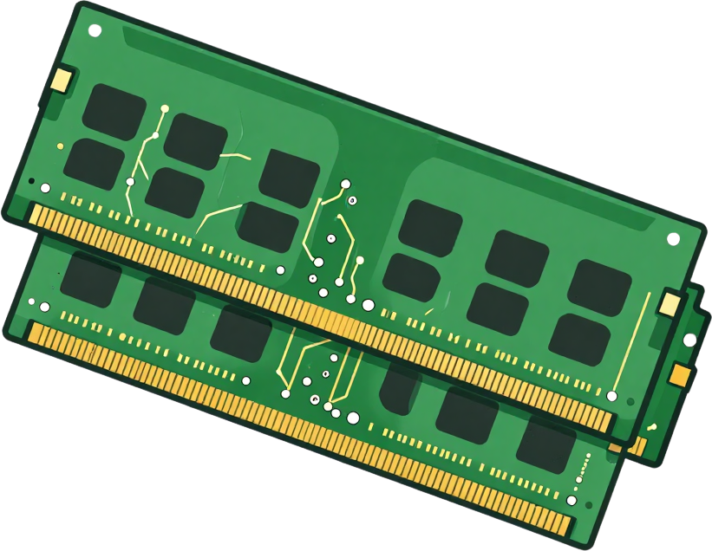
Day 1 – Engineering & Product Foundation
What I Learned:
• Software Engineering • Product vs Project • SDLC • Agile Development • MVP
• Frontend, Backend & Database • REST API • QA & DevOps
• Cloud Infrastructure • Authentication & Authorization • Documentation & Code Review
Key Learning:
"Software development is a complete process, not just writing code."
From planning and design to testing, deployment, and documentation — every phase matters. Engineering is about building systems that are scalable, maintainable, and collaborative.

Slide 4





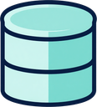








How a Software System Works
Data flow from user interaction through frontend, API, backend, business logic, and database
User
REST API
Business Logic
User initiates a request through a browser or mobile app interface to interact with the system.
REST API connects frontend and backend, routing requests, validating inputs, and managing authentication.
Business logic layer enforces core application rules, data transformations, and workflow processing.
Frontend
Backend
Database
Frontend handles user interaction, renders UI components, and sends requests to the REST API layer.
Backend processes incoming requests, applies authorization rules, and coordinates business logic execution.
Database stores and retrieves application data securely, returning results up through the system layers.

Slide 5
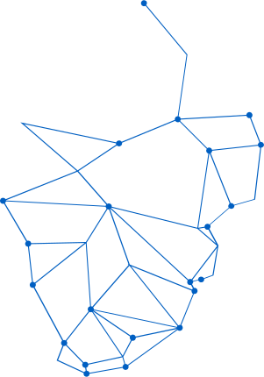
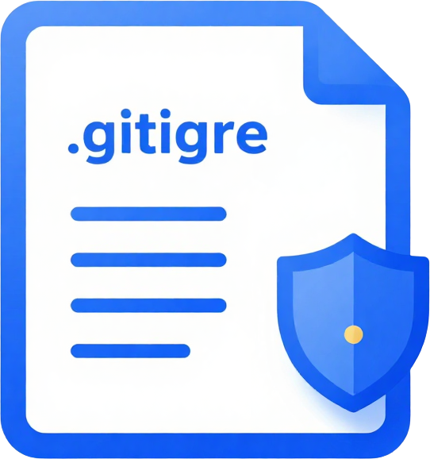
DAY 2 – GIT & VERSION CONTROL
.gitignore – Keeping Your Repo Clean
• Tells Git which files to ignore and not track
• Prevents committing sensitive files (e.g., .env, API keys)
• Excludes build artifacts, logs, and OS-specific files
• Supports wildcards and pattern matching rules
README – Your Project's Front Page
• First file developers see when visiting a repository
• Describes the project purpose, setup, and usage
• Written in Markdown (.md) for easy formatting
• Includes badges, links, and contribution guidelines

Slide 6
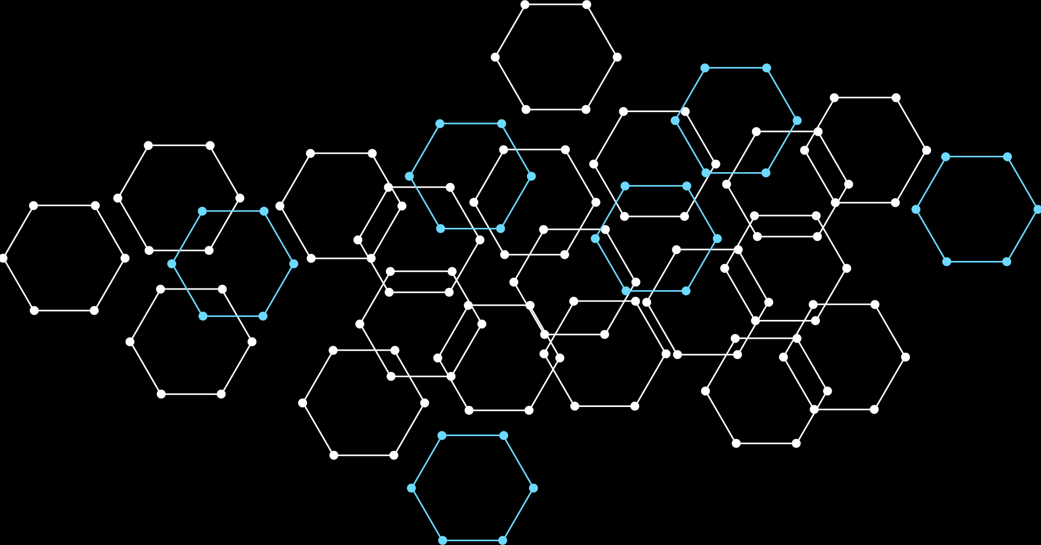



DAY 2 – GIT &
VERSION CONTROL
Repository: A storage location where your project's files and the entire revision history are tracked. Local repos live on your machine; remote repos (e.g., GitHub) are hosted online for collaboration.
Clone: Creates a full local copy of a remote repository on your machine, including all branches and commit history. Use git clone to get started on an existing project.
Branch: An independent line of development. Branching lets you work on features or fixes in isolation without affecting the main codebase. Common branches: main, develop, feature/, hotfix/.

Slide 7



DAY 2 – GIT & VERSION CONTROL
Add & Commit — Stage changes with git add to prepare files for tracking, then use git commit to save a snapshot of your work with a meaningful message describing what changed.
Push & Pull — Use git push to upload your local commits to a remote repository on GitHub, and git pull to fetch and integrate the latest changes from the remote into your local branch.
Fetch & Merge — git fetch downloads new data from the remote without modifying your working files, while git merge combines a target branch's history into your current branch safely.

Slide 8



DAY 2 – GIT &
VERSION CONTROL
Pull Request: A request to merge code from one branch into another. It enables team collaboration by allowing others to review your changes before they are integrated into the main codebase on GitHub.
Code Review: The process where teammates examine a Pull Request's code for bugs, style, and logic. Reviewers can comment, request changes, or approve the PR before it gets merged into the target branch.
Merge Conflict: Occurs when two branches modify the same lines differently. Git cannot auto-merge them, so the developer must manually resolve conflicts by editing the file and choosing which changes to keep.

Slide 9
DAY 2 – GIT & VERSION CONTROL
.gitignore – Keeping Your Repo Clean
• Tells Git which files to ignore and not track
• Prevents committing sensitive files (e.g., .env, API keys)
• Excludes build artifacts, logs, and OS-specific files
• Supports wildcards and pattern matching rules
README – Your Project's Front Page
• First file developers see when visiting a repository
• Describes the project purpose, setup, and usage
• Written in Markdown (.md) for easy formatting
• Includes badges, links, and contribution guidelines

Slide 10
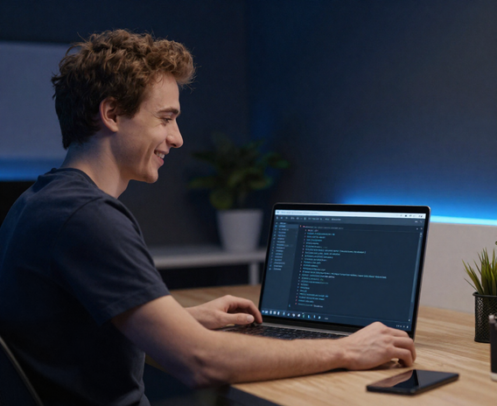



DAY 3 – LINUX & DEV ENVIRONMENT
Linux Skills
pwd & ls
Print working directory and list files in the current directory to navigate your filesystem with confidence.
cd & mkdir
touch
Change directories and create new folders to organize your project structure from the terminal.
Create new empty files instantly from the command line, a foundational skill for every Linux developer.
Navigation Basics
Mastering pwd, ls, cd, mkdir, and touch gives you full control over the Linux filesystem and project setup.

Slide 11
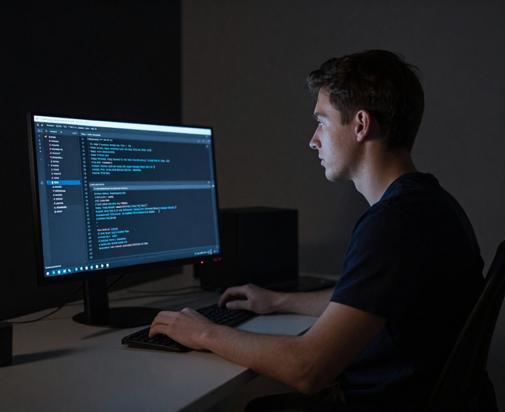
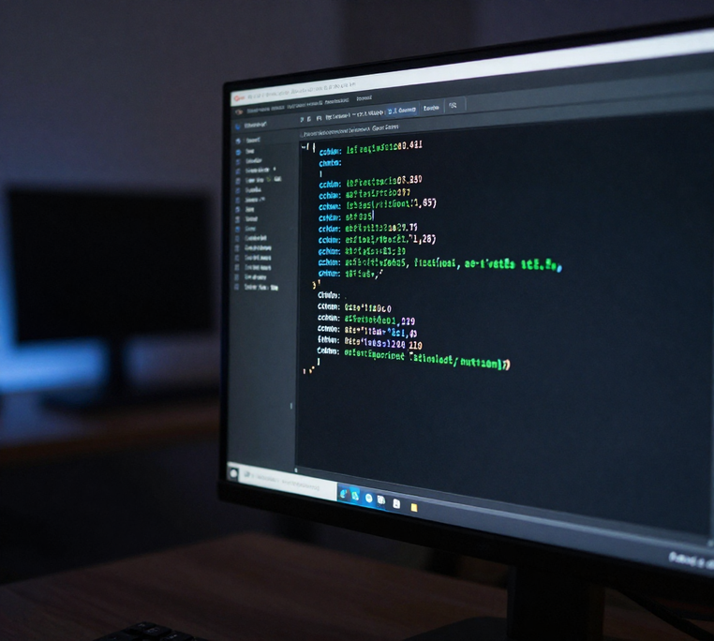
Files & Directories
Processes & Ports
Understanding the Linux filesystem structure, navigating directories with pwd, ls, and cd, and managing files using mkdir, touch, cp, mv, and rm for organized project structure.
Monitoring active processes with ps and top, checking network connectivity via curl and ping, and understanding how services bind to ports for local development and debugging.
Permissions
Managing file and directory access using chmod, understanding read, write, and execute permission flags, and controlling user-level access across the development environment.
ENVIRONMENT CONCEPTS

Slide 12
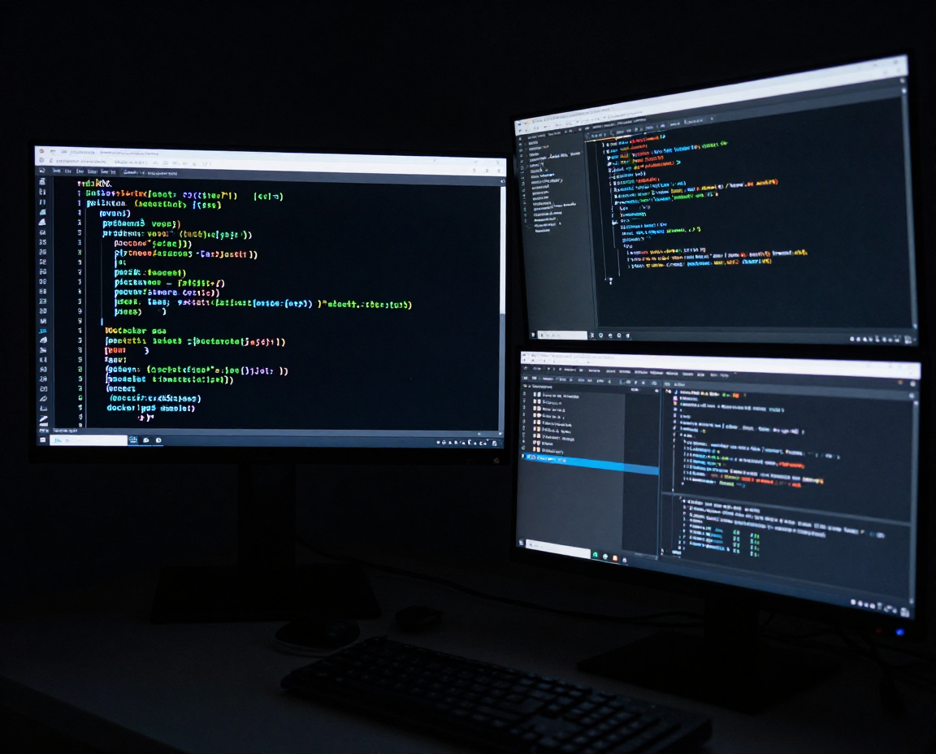

DAY 3 – PRACTICAL WORK
Project Setup:
• Created project folder structure
• Set up Python virtual environment
• Installed packages via pip
• Created .env.example file
Verification Steps:
• Verified PostgreSQL running & accessible
• Confirmed Docker daemon active
• Checked localhost in browser
• Tested environment variables loaded correctly
Hands-On
Exercises

Slide 13






DAY 4 – AGILE, USER STORIES & SPRINT WORKING
Business Requirement → Epic → User Story → Task/Subtask → Acceptance Criteria → Testing
Business
Requirement
Epic
User Story
Task /
Subtask
Acceptance
Criteria
Testing
Group related features into an Epic. Example: Leave Management – covering requests, approvals, and tracking
"As an employee, I want to submit a leave request so that my manager can approve or reject my absence."
Validate test scenarios: submit request, approve/reject flow, edge cases, and regression checks
Capture stakeholder needs and define the business problem to be solved
Break user stories into tasks: UI form design, API integration, notification setup, and database schema
Define done: employee submits form, manager notified, status updates to Approved or Rejected
Step 1
Step 2
Step 3
Step 4
Step 5
Step 6

Slide 14







DAY 4 – AGILE, USER STORIES & SPRINT WORKING
Key Agile concepts that drive iterative delivery and continuous improvement
Product Backlog
Sprint
Story Points
Definition of Done
Sprint Planning
Stand-up, Review & Retro
A prioritized list of all features, user stories, and tasks to be delivered in the project
A fixed time-box (1–4 weeks) in which the team delivers a potentially shippable product increment
Relative units used to estimate effort, complexity, and size of user stories in the backlog
A shared checklist of criteria that a user story must meet before it is considered complete
Team selects backlog items and defines Sprint goals and tasks for the upcoming Sprint cycle
Daily sync, end-of-Sprint demo to stakeholders, and team retrospective for continuous improvement
01
02
03
04
05
06

Slide 15






Leave Management – Practical Example
3
Frontend Layer
POST /leave-requests sent to backend; request payload includes employee ID, dates, and leave type
Connecting architecture, APIs, database design, and business rules
1
Employee
4
Backend Validation
Employee initiates leave request through the HR portal or mobile application interface
Business rules enforced: validate leave balance, check overlapping requests, verify eligibility
2
Apply Leave
5
Database
Form submission captures leave type, start date, end date, and reason for absence
Leave request persisted with status set to Pending, awaiting manager review and approval

Slide 16

Day 5
Why Documentation Matters
GOOD DOCUMENTATION MAKES DEVELOPMENT CLEAR, CONSISTENT AND MAINTAINABLE.

Slide 17
WHY DOCUMENTATION MATTERS
1
README
5
Database Documentation
2
Functional Requirements
6
Architecture
3
Technical Documentation
7
Engineering Standards
4
API Documentation
2

Slide 18
WHY IT MATTERS
Good Documentation Makes Development Clear, Consistent and Maintainable
Clear Development
Consistent Practices
Maintainable Codebase
Well-written documentation removes ambiguity, helping every team member understand the system's purpose, structure, and expected behavior at a glance.
Shared standards across READMEs, engineering guidelines, and changelogs ensure teams work in alignment, reducing errors and onboarding friction.
Comprehensive technical and architectural documentation enables teams to evolve the system confidently, without fear of breaking undocumented dependencies.
3

Slide 19
What I Found Difficult
Linux & Command Line
• Linux was completely new to me
• Basic commands and terminal operations were initially unfamiliar
• Understanding permissions, processes, SSH and environment variables took time and also exploring about local hosts and understanding system design.

Slide 20

What I Need to Improve
Linux
System Design
Documentation
Practice more commands, file permissions, process management, and system troubleshooting to build confidence at the command line.
Deepen understanding of software architecture patterns and how system components interact, scale, and communicate with each other.
Gain more experience writing clear, concise, and technically detailed documentation that is easy for developers to understand and follow.
Skills Development
Improvement Areas

Slide 21


Core
Concepts
Week 1
MY KEY
LEARNINGS
FROM WEEK 1
Engineering Mindset
Requirements First
Collaboration with Git
Software engineering is far more than writing code. It involves problem-solving, communication, planning, and understanding the broader system — turning ideas into reliable, maintainable solutions.
Every feature begins with a clear understanding of the requirement. Before writing a single line of code, engineers must define the problem, clarify expectations, and align with stakeholders on the desired outcome.
Git empowers developers to work safely and collaboratively. Version control enables teams to track changes, experiment without risk, and merge contributions seamlessly across distributed workflows.

Slide 22
Thank You!
Rohit Raj Singh

